Slide 1
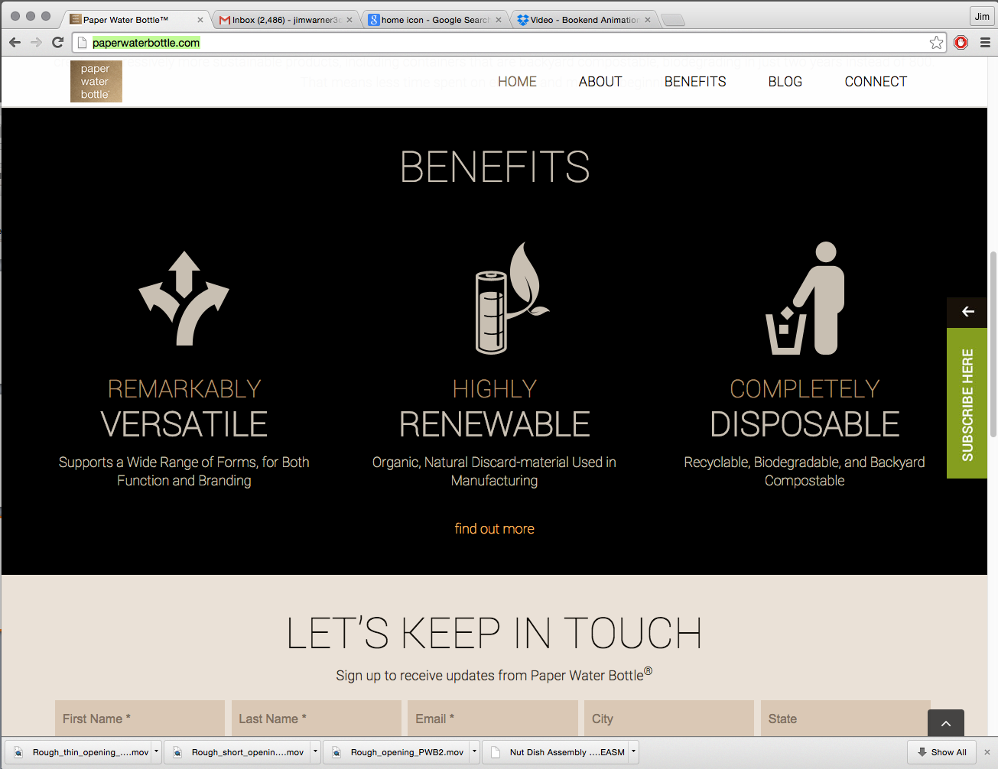




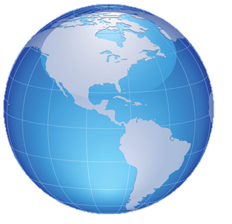


Our Story It’s Genius Blog Contact Us
Paper Water Bottle®: It’s Genius
Pulp Exoskeleton
Brandable
Specially blended combination of wheat straw, bamboo, husks, sugar cane, and/or bulrush
It has unlimited shape, aesthetic and functional capability; utilizes existing operations
Content Barrier
Sustainable
80%+ less material utilized than anything used worldwide, microscopic layering, 100% organic
Uses an array of organic, natural, renewable resources and materials worldwide
Human Response
Compostable
People of all generations, backgrounds, and locations globally recognize the value and smile
Guilt-Free® disposability, biodegradable,
able to be Backyard Compostable®

